Slide 1


Thomas Wood
6/13/2023

Slide 2

Outline
Executive Summary
Introduction
Methodology
Results
Conclusion
Appendix

Slide 3
Executive Summary
The analysis aims to assess what factors leads to a successful rocket landing.
Summary of methodologies
The following data science techniques were used:
Collect: web scrapping of Space X data using their API
Wrangling the data to create a fail/success variable.
Explore and analyze the data using data visualization, SQL, dash boards and maps.
Apply various ML techniques to aim to predict successful launch factors.
Summary of all results
Launch success has improved over time. Orbits GEO, HEO, SSO and ES-L1 have 100% success rate.

Slide 4
Introduction
Project background and context
The commercial space age is here, companies are making space travel affordable for everyone. Virgin Galactic is providing suborbital spaceflights. Rocket Lab is a small satellite provider. Blue Origin manufactures sub-orbital and orbital reusable rockets. Perhaps the most successful is SpaceX.
SpaceX’s accomplishments include: Sending spacecraft to the International Space Station. Starlink, a satellite internet constellation providing satellite Internet access. Sending manned missions to Space. One reason SpaceX can do this is the rocket launches are relatively inexpensive. SpaceX advertises Falcon 9 rocket launches on its website with a cost of 62 million dollars; other providers cost upwards of 165 million dollars each, much of the savings is because SpaceX can reuse the first stage. Therefore, if we can determine if the first stage will land, we can determine the cost of a launch.
The payload is enclosed in the fairings. Stage two, or the second stage, helps bring the payload to orbit, but most of the work is done by the first stage. This stage does most of the work and is much larger than the second stage.
This stage is quite large and expensive. Unlike other rocket providers, SpaceX's Falcon 9 Can recover the first stage.
Sometimes the first stage does not land. Other times, Space X will sacrifice the first stage due to the mission parameters like payload, orbit, and customer.

Slide 5
Introduction
Problems you want to find answers
In this capstone, we will predict if the Falcon 9 first stage will land successfully. SpaceX advertises Falcon 9 rocket launches on its website, with a cost of 62 million dollars; other providers cost upward of 165 million dollars each, much of the savings is because SpaceX can reuse the first stage.
Therefore if we can determine if the first stage will land, we can determine the cost of a launch. This information can be used if an alternate company wants to bid against SpaceX for a rocket launch.

Slide 6

Section 1

Slide 7
Methodology
Executive Summary
Data collection methodology:
Data was collected using Space X REST API and web scrapping Wikipedia
Perform data wrangling
One-hot encoding applied the categorical features
Perform exploratory data analysis (EDA) using visualization and SQL
Perform interactive visual analytics using Folium and Plotly Dash
Perform predictive analysis using classification models
How to build, tune, evaluate classification models

Slide 8
Data Collection
The SpaceX REST API endpoints, or URL, starts with api.spacexdata.com/v4/. We have the different end points, for example: /capsules and /cores We will be working with the endpoint api.spacexdata.com/v4/launches/past.
We will perform a get request using the requests library to obtain the launch data, which we will use to get the data from the API. This result can be viewed by calling the .json() method. Our response will be in the form of a JSON, specifically a list of JSON objects. The we convert the JSON objects into a dataframe.
We will also be using the Python BeautifulSoup package to web scrape some HTML tables that contain valuable Falcon 9 launch records in Wikipedia.

Slide 9
Data Collection – SpaceX API
Request rocket launch data from SpaceX API using URL and get request
Decode the response content as a Json and turn it into a Pandas dataframe
Create a new data frame
Parse key information, store in list using helperfunctions
Source SpaceX data using json, get , parse and save as dataframe.
GitHub URL: Data collection API

Slide 10
Data Collection - Scraping
Request Falcon9 Launch data from Wikipedia using get request
Create a BeautifulSoup object from response text content
Create a data frame by parsing the launch HTML tables
Extract column names using BeautifulSoup
Present your web scraping process using key phrases and flowcharts
GitHub URL: Data Collection with Web Scraping

Slide 11
Data Wrangling
Convert outcomes into Training Labels with 1 meaning the booster successfully landed and 0 meaning it was unsuccessful.
Add classification column
Create a list where the element is zero if the corresponding row in Outcome is in the set ‘bad outcome’ ; otherwise, it's one
Created a classification column with good or bad outcomes from the different type of landing outcomes
Add the GitHub URL: Data Wrangling

Slide 12
EDA with Data Visualization
Following charts are presented:
FlightNumber vs. PayloadMass + Outcome Overlay: shows increased 1st stage landing success as number of flights increase. But shows lesser chance of stage 1 return, when payloads increase.
Relationship between Flight Number and Launch Site: increased success with increasing flight numbers on all launch sites.
Relationship between Payload and Launch Site: VAFB-SLC launch site there are no rockets launched for heavy pay load mass (greater than 10000).
Relationship between success rate of each orbit type: ESL1, GEO, HEO and SSO have 100% success rate.
Relationship between Flight Number and Orbit type: LEO orbit the Success appears related to the number of flights; on the other hand, there seems to be no relationship between flight number when in GTO orbit.
Relationship between Payload and Orbit type: heavy payloads the successful landing or positive landing rate are more for Polar,LEO and ISS.
Launch success yearly trend: shows increase success over the years
GitHub URL: EDA with Data Visualization

Slide 13
EDA with SQL
Using bullet point format, summarize the SQL queries you performed
After downloading the datasets:
Identified the unique launch sites
Display 5 records where launch sites begin with the string 'CCA’
Display the total payload mass carried by boosters launched by NASA (CRS)
Display average payload mass carried by booster version F9 v1.1
List the date when the first successful landing outcome in ground pad was achieved.
List the names of the boosters which have success in drone ship and have payload mass greater than 4000 but less than 6000
List the total number of successful and failure mission outcomes
List the names of the booster versions which have carried the maximum payload mass. Use a subquery
List the records which will display the month names, failure landing outcomes in drone ship ,booster versions, launch site for the months in year 2015.
Rank the count of successful landing outcomes between the date 04-06-2010 and 20-03-2017 in descending order.
GitHub URL: Complete the EDA with SQL.ipynb

Slide 14
Build an Interactive Map with Folium
Adding markers at the different launch sites and the launch outcomes for each site, and see which sites have high success rates.
GitHub URL: Locations Analysis with Folium

Slide 15
Build a Dashboard with Plotly Dash
Summarize what plots/graphs and interactions you have added to a dashboard: Input Launch site and Payload Range (Slider)
Output:
Pie chart showing:
Success of launches at all launch sites combined
Success and failure for each selected launch site
Scatter Plot showing success rate for each Booster Version and Payload Mass
Explain why you added those plots and interactions: The graphs allow to assess the successful relationship of Booster versions and Payload Mass in relationship to the different Launch Sites.
GitHub URL: Space X Dash

Slide 16
Predictive Analysis (Classification)
Summarize how you built, evaluated, improved, and found the best performing classification model
Task 1: Created a separate array with all outcomes (‘Class’/ Y)
Task 2: Standardized the data frame (X)
Task 3: Split the data into train and test data.
Applied Logistic regression, Support Vector Machine, Decision Tree Classifer and K-nearest Neighbors to the training data. Used the best parameters to predict and then measure the accuracy.
Best models are Decision Tree Classifier and K-Nearest Neighbors with similar outcomes (SVM did not work due to lack of computing power.
You need present your model development process using key phrases and flowchart
GitHub URL: Machine Learning Prediction

Slide 17
Results
Exploratory data analysis results
Interactive analytics demo in screenshots
Predictive analysis results

Slide 18

Section 2

Slide 19
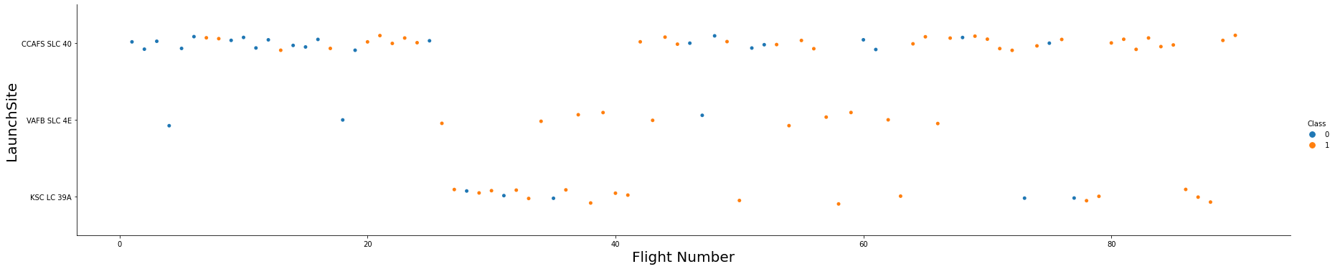
Flight Number vs. Launch Site
Regardless of launch site, success rates increased over time.
Classification is 1 = Good outcome, 0 = Bad outcome

Slide 20
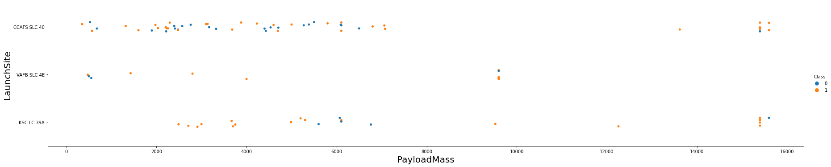
Payload vs. Launch Site
VAFB-SLC launchsite there are no rockets launched for heavypayload mass(greater than 10000)
Classification is 1 = Good outcome, 0 = Bad outcome

Slide 21
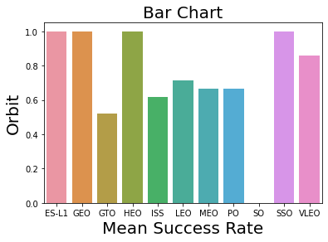
Success Rate vs. Orbit Type
ES-LI, GEO, HEO & SSO have a 100% success rate

Slide 22
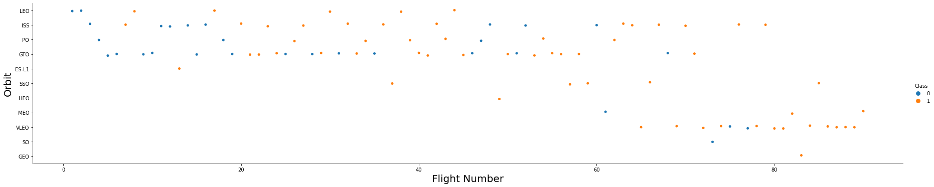
Flight Number vs. Orbit Type
LEO orbit the Success appears related to the number of flights; on the other hand, there seems to be no relationship between flight number when in GTO orbit.

Slide 23
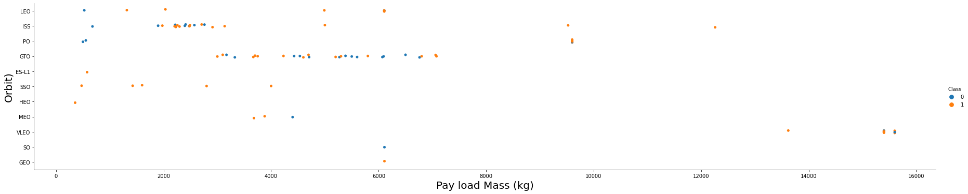
Payload vs. Orbit Type
With eavy payloads the successful landing or positive landing rate are more for Polar,LEO and ISS.
However for GTO we cannot distinguish this well as both positive landing rate and negative landing(unsuccessful mission) are both there here.

Slide 24
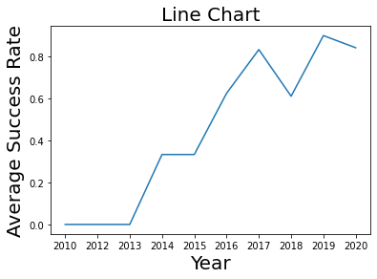
Launch Success Yearly Trend
The sucess rate since 2013 kept increasing till 2020

Slide 25

Section 4

Slide 26
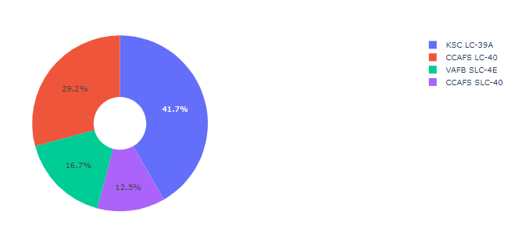
Launch success across launch sites
Data shows that the KSC LC-39A has the biggest percentage of successful launches overall.

Slide 27
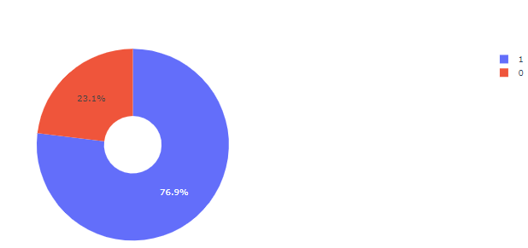
KSC LC has the highest success rate
KSC LC has the highest success rate at 76.9%

Slide 28
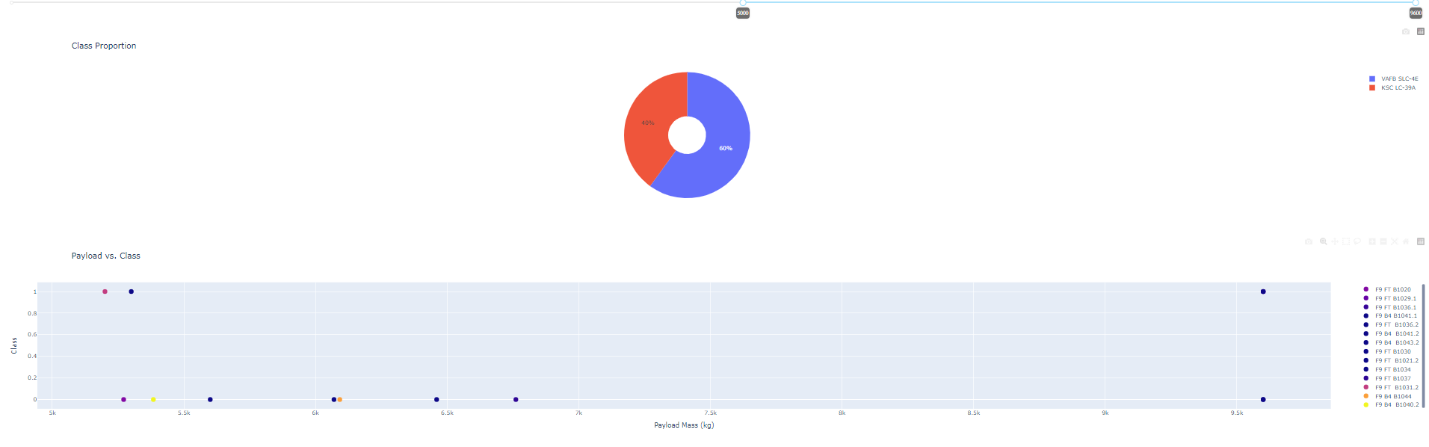
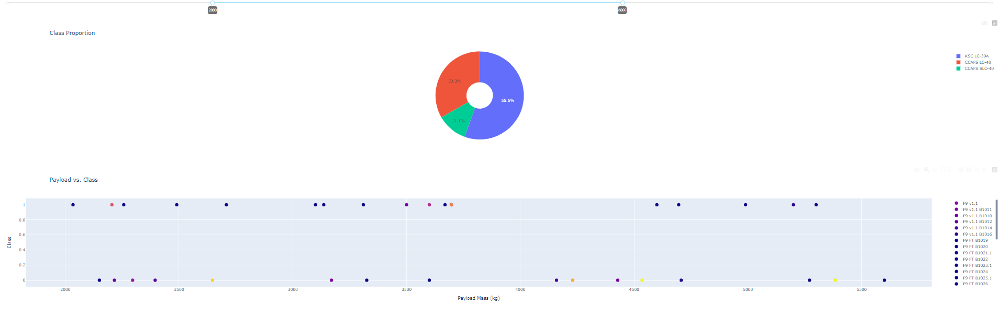
Payload vs. Launch Outcome scatter plot
Higher payloads on VAFB SLC-4E and KSC LC-39A only
Lower payloads

Slide 29

Section 5

Slide 30
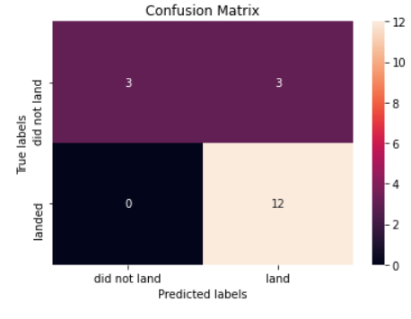
Confusion Matrix
Decision tree classifier object has the highest accuracy. The issue is the high number of false predicted successful landings.

Slide 31
Conclusions
The Decision tree classifier is the best machine learning algorithm for this task.

Slide 32
Appendix
Git Hub URL: IBM Data Cert

Slide 33


